Slide 1
HOUSE PRICE PREDICTION
Ankit(D21006)
Vaishnavi dasari(D21037)

Slide 2
HYPOTHESIS
1.Price of House increases with increase in sqft_living.
2.Price of house is moderate with increase in bathrooms.
3.Houses with good view cost more .
4.House with more bedrooms have more price.
5.Location of the house effect the price of the house.

Slide 3
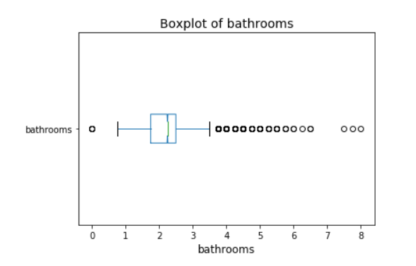
EDA
UNIVARIATE ANALYSIS:
From the univariate analysis of bathrooms given below there are more values above the upper threshold and few values below lower threshold.

Slide 4
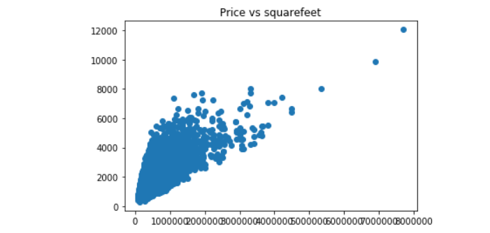
BIVARIATE ANALYSIS
When we plot scatter plot for Price vs square feet we can see that more the living area , more the price though data is concentrated towards a particular price zone , but from the figure we can see that the data points seem to be in linear direction.

Slide 5
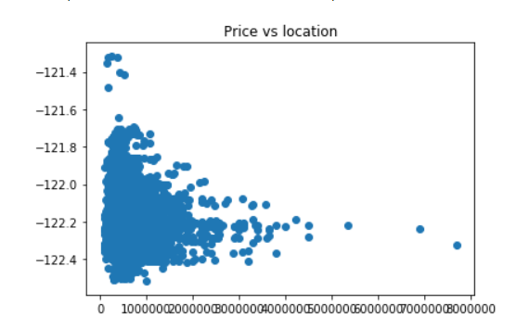
When we plot scatter plot for Price vs location we can say that the location of the houses in terms of longitude and it gives us quite an interesting observation that -122.2 to -122.4 sells houses at much higher amount.

Slide 6
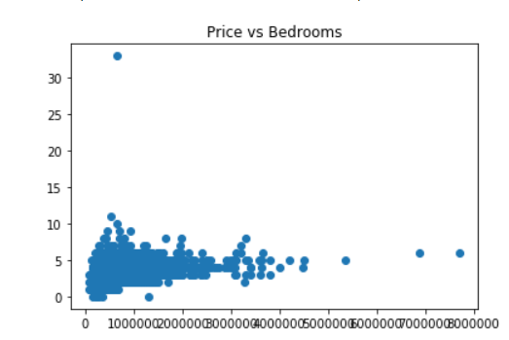
When we plot scatter plot for Price vs bedrooms we can see that 0 to 10 bedrooms, more the price though data is concentrated towards a particular price zone ,As the bedroom increase to 33 we do not see high price, maybe it is an outlier.

Slide 7
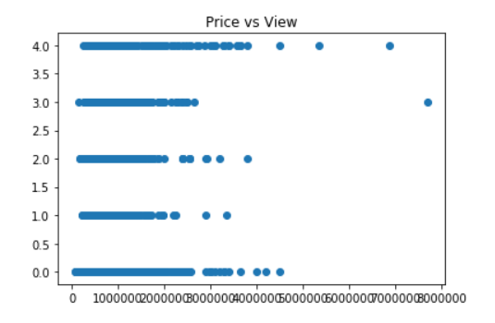
When we plot scatter plot for Price vs View we can see that better the view better the price but with 3 as view also we have the best price.

Slide 8
CORRELATION
By calculating the correlation we can see that these have the best value with price: bathrooms- 0.5275117130183178 sqft_living- 0.7050436600678007 grade-0.6655939026268423 sqft_above- 0.6114500383666939 sqft_living15-0.5848293476203167
As can see that sqft_living,sqft_lot,sqft_above,sqft_basement,sqft_living15,sqft_lot15 as predictors as they show linear in scatter plot and are continuous data.

Slide 9
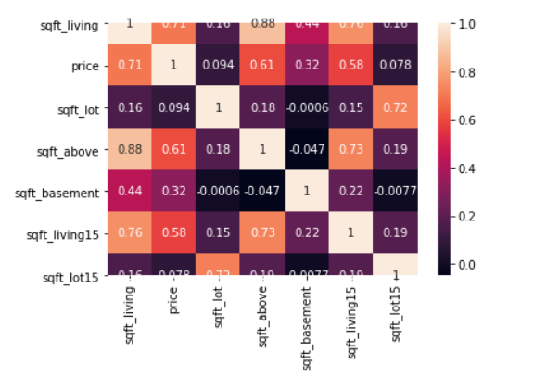
The heat map represents the correlation between the price and others so we can see the correlation.

Slide 10
LINEAR REGRESSION MODEL FITTING
Model 1
We are taking sqft_living. Considering sqft_living it has good correlation with price.
X1=train[["sqft_living"]]
RMSE: 269729.4196380303
R2: 0.48970786331171967
Model 2
We are taking sqft_living,sqft_lot. Considering sqft_lot it has highest correlation as we see heatmap
X2=train[["sqft_living","sqft_lot"]]
RMSE: 269683.9484240291
R2: 0.48990630289854853

Slide 11
Model 3
We are taking sqft_living,sqft_lot,sqft_above,sqft_basement.
Consider sqft_basement we do not have good correlation but with maybe we can see change
X3=train[["sqft_living","sqft_lot","sqft_above","sqft_basement"]]
RMSE: 269683.9484240291
R2: 0.48990630289854853
Model 4
We are taking sqft_living,sqft_lot,sqft_above,sqft_basement,sqft_living15,sqft_lot15
Considering all to see if there is any change
X4=train[["sqft_living","sqft_lot","sqft_above","sqft_basement","sqft_living15","sqft_lot15"]]
RMSE: 267954.8474747896
R2: 0.4972788738327651

Slide 12
Model 5
We are taking sqft_living,sqft_lot,sqft_living15,sqft_lot15
Considering all with best correlation to see if there is any change
X5=train[["sqft_living","sqft_lot","sqft_living15","sqft_lot15"]]
RMSE: 268127.46666367096
R2: 0.49651529570938974
Model 6
We are taking sqft_lot,sqft_basement,sqft_lot15
Considering all which are most positively skewed to see if there is any change
X6=train[["sqft_lot","sqft_basement","sqft_lot15"]]
RMSE: 358316.05859811633
R2: 0.103943191221425

Slide 13
FEATURE TRANSFORMATION
As our data has outliers which cause data to be positively skewed for few parameters. This can be reduced using feature transformation.
"sqft_lot","sqft_lot15","sqft_basement"
We are taking these as these are the most positively skewed variables.
We can use the following feature transformations, they are square root, log+1 as sqft_basement log is not possible and squaring.

Slide 14
1.Taking Square Root
S=np.sqrt(train[["sqft_lot","sqft_lot15","sqft_basement"]])
RMSE: 362555.1166594581
R2: 0.08369400098338119
We can see a slight change in RMSE and R2 but RMSE increased and R2 decreased so it is not suitable.
RMSE from 358316.0585 to 362555.116
R2 from 0.103 to 0.083
2.Taking Log
S2=np.log(train[["sqft_lot15","sqft_lot","sqft_basement"]]+1)
RMSE: 365780.57299123245
R2: 0.06790496500426475
While we are taking log we are getting error for sqft_basement so we will take log+1
We can see a very small change
RMSE from 358316.0585 to 365780.572
R2 from 0.103 to 0.067

Slide 15
3.Squaring
S3=np.square(train[["sqft_lot15","sqft_lot","sqft_basement"]]+1)
RMSE: 352323.0221264352
R2: 0.12998158477098248
When we are squaring we can see that R2 increases and RMSE decreases.
It may be suitable but the change is small.
RMSE from 358316.0585 to 352323.022
R2 from 0.103 to 0.129

Slide 16
NEW FEATURE
We are creating new column for age of the building by subtracting year in date and the yr_built.
This will add new feature from the existing features and will be a new feature to learn for model.
For getting the year from date convert it into datetime datatype
train["date"] = pd.to_datetime(train["date"])
train["age"]= train['year']-train['yr_built']
train.head()
Now let's try linear regression on the new column
Xn= train[['age']]
RMSE: 379431.1183192284
R2: -0.0008596735670498012
We are getting negative r2

Slide 17
FORWARD SELECTION
In forward selection train model using each feature individually and check the performance and for the variable with best performance, we repeat the process and add one variable at a time. It repeats until there is no significant improvement in the model's performance.
For all the models taking forward as true and doing forward selection we can see that the RMSE decreased and R2 increased slightly but not a big difference to be seen.

Slide 18
BACKWARD ELIMINATION
In backward elimination train model using all feature and check the performance, drop one variable at a time and check performance.
For all the models taking forward as true and doing forward selection we can see that the RMSE decreased and R2 increased slightly but not a big difference to be seen.

Slide 19
DECISION TREE
We did Hypertuning to get better model where max_dept is number of predictors-1 and min_samples_leaf as 1.
For the model 1 we got the highest RMSE and least R2 ,which is not a good model.
For the model 2 we got the highest RMSE and least R2 ,which is not a good model.
For the model 3 we can see that RMSE Decreased and R2 increased but not good enough.
For the model 4 we can see that RMSE Decreased and R2 increased but not good enough.
For the model 5 we can see that RMSE Decreased and R2 increased but not good enough.
For the model 6 we can see that RMSE Decreased and R2 increased but not good enough.

Slide 20
For the model 7 we are using feature transformation square root, we can see that RMSE and R2 does not have change and similar with other feature transformations.
For the model 8 we are using feature transformation log, we can see that RMSE and R2 does not have change and similar with other feature transformations.
For the model 9 we are using feature transformation squaring, we can see that RMSE and R2 does not have change and similar with other feature transformations.
For the model 10 we are using new feature age, we can see highest RMSE and least R2 ,which is not a good model.

Slide 21
Model 11 for different features ["age","long","lat","sqft_living","sqft_lot15","sqft_lot","sqft_basement"]
RMSE: 204512.96207653877 ,R2 0.7007522578105545
Model 12 for different features ["grade","lat","sqft_living","sqft_above","sqft_lot","bathrooms"]
RMSE: 217206.79268947375 ,R2 0.6660423811430605
Model 13 for different features ["sqft_living","grade","lat","bathrooms",'long','sqft_lot15’]
RMSE: 213682.85225564733 ,R2: 0.6764680582317251
Model 14 for different features ["sqft_living","grade","lat","bathrooms",'long','bedrooms','view’]
RMSE: 195567.36351982984 , R2 0.7317707201998267

Slide 22
TESTING
For model 14 we got the best result .
Using model 14 for test data,
X=(test[["sqft_living","grade","lat","bathrooms",'long','bedrooms','view']])
Y=test[["price"]]
RESULT:
The model 14 has more R2 and less RMSE compare to others.
The Model 14 is best performing model
In model 14 features
["sqft_living","grade","lat","bathrooms",'long','bedrooms','view’] are able to explain 70% of the variation in house prices.

Slide 23
THANK YOU

